Slide 1
TECHNOLOGY IN AFRICA
Exploring men and women in the tech industry in Africa.

Slide 2
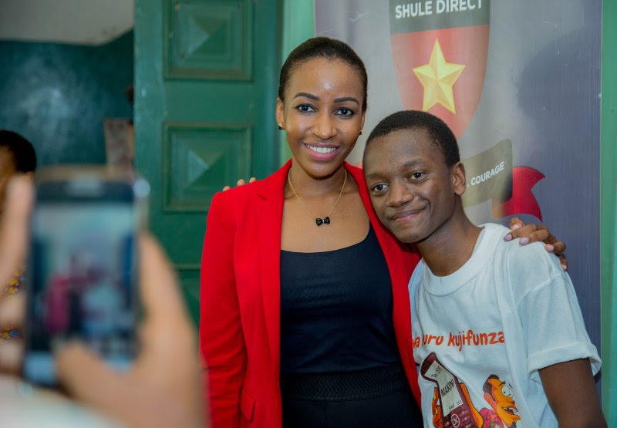
Faraja Nyalandu
Background
Organisation
When it was started
Where it is based
Goals and objectives

Slide 3
Amani Joseph
Background
Organisation
When it was started
Where it is based
Goals and objectives

Slide 4
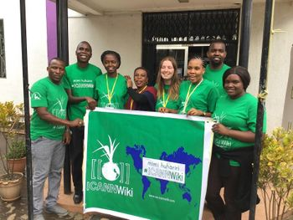
Jane Langoi & Rebecca Ryakitimbo
Background
Organisation
When it was started
Where it is based
Goals and objectives

Slide 5
Lilian Makoi
Background
Organisation
When it was started
Where it is based
Goals and objectives

Slide 6
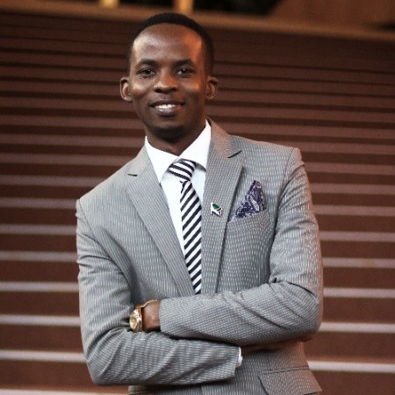
Isaya Yunge
Background
Organisation
When it was started
Where it is based
Goals and objectives

Slide 7
Kijoli Mjombo
Background
Organisation
When it was started
Where it is based
Goals and objectives

Slide 8

Johnpaul Baretto & Mrusha Jones
Background
Organisation
When it was started
Where it is based
Goals and objectives

Slide 9
Taha Jiwaji
Background
Organisation
When it was started
Where it is based
Goals and objectives

Slide 10
Conclusion
Summary
Word of thanks
Work done by:
Joy Wahome.

